Slide 1
Conflict clauses and resolution
Consider the following example:
Conflict clause: c₅: (x₂ Ç :x₄ Ç x₁₀)
We show that c₅ is inferred by resolution from c₁,…,c₄

Slide 2
Conflict clauses and resolution
Conflict clause: c₅: (x₂ Ç :x₄ Ç x₁₀)
BCP order: x₄,x₅,x₆,x₇
T1 = Res(c₄, c₃, x₇) = (:x₅ Ç :x₆)
T2 = Res(T1, c₂, x₆) = (:x₄ Ç :x₅ Ç X₁₀ )
T3 = Res(T2, c₁, x₅) = (x₂ Ç :x₄ Ç x₁₀ )
Notes:
Note that all the clauses on the way are
implied by the formula (as they are a result of resolving existing clauses, or clauses derived from existing clauses), and hence can be added.
conflict clauses (but not necessarily asserting), associated with a cut separating the roots from the conflict.
2

Slide 3
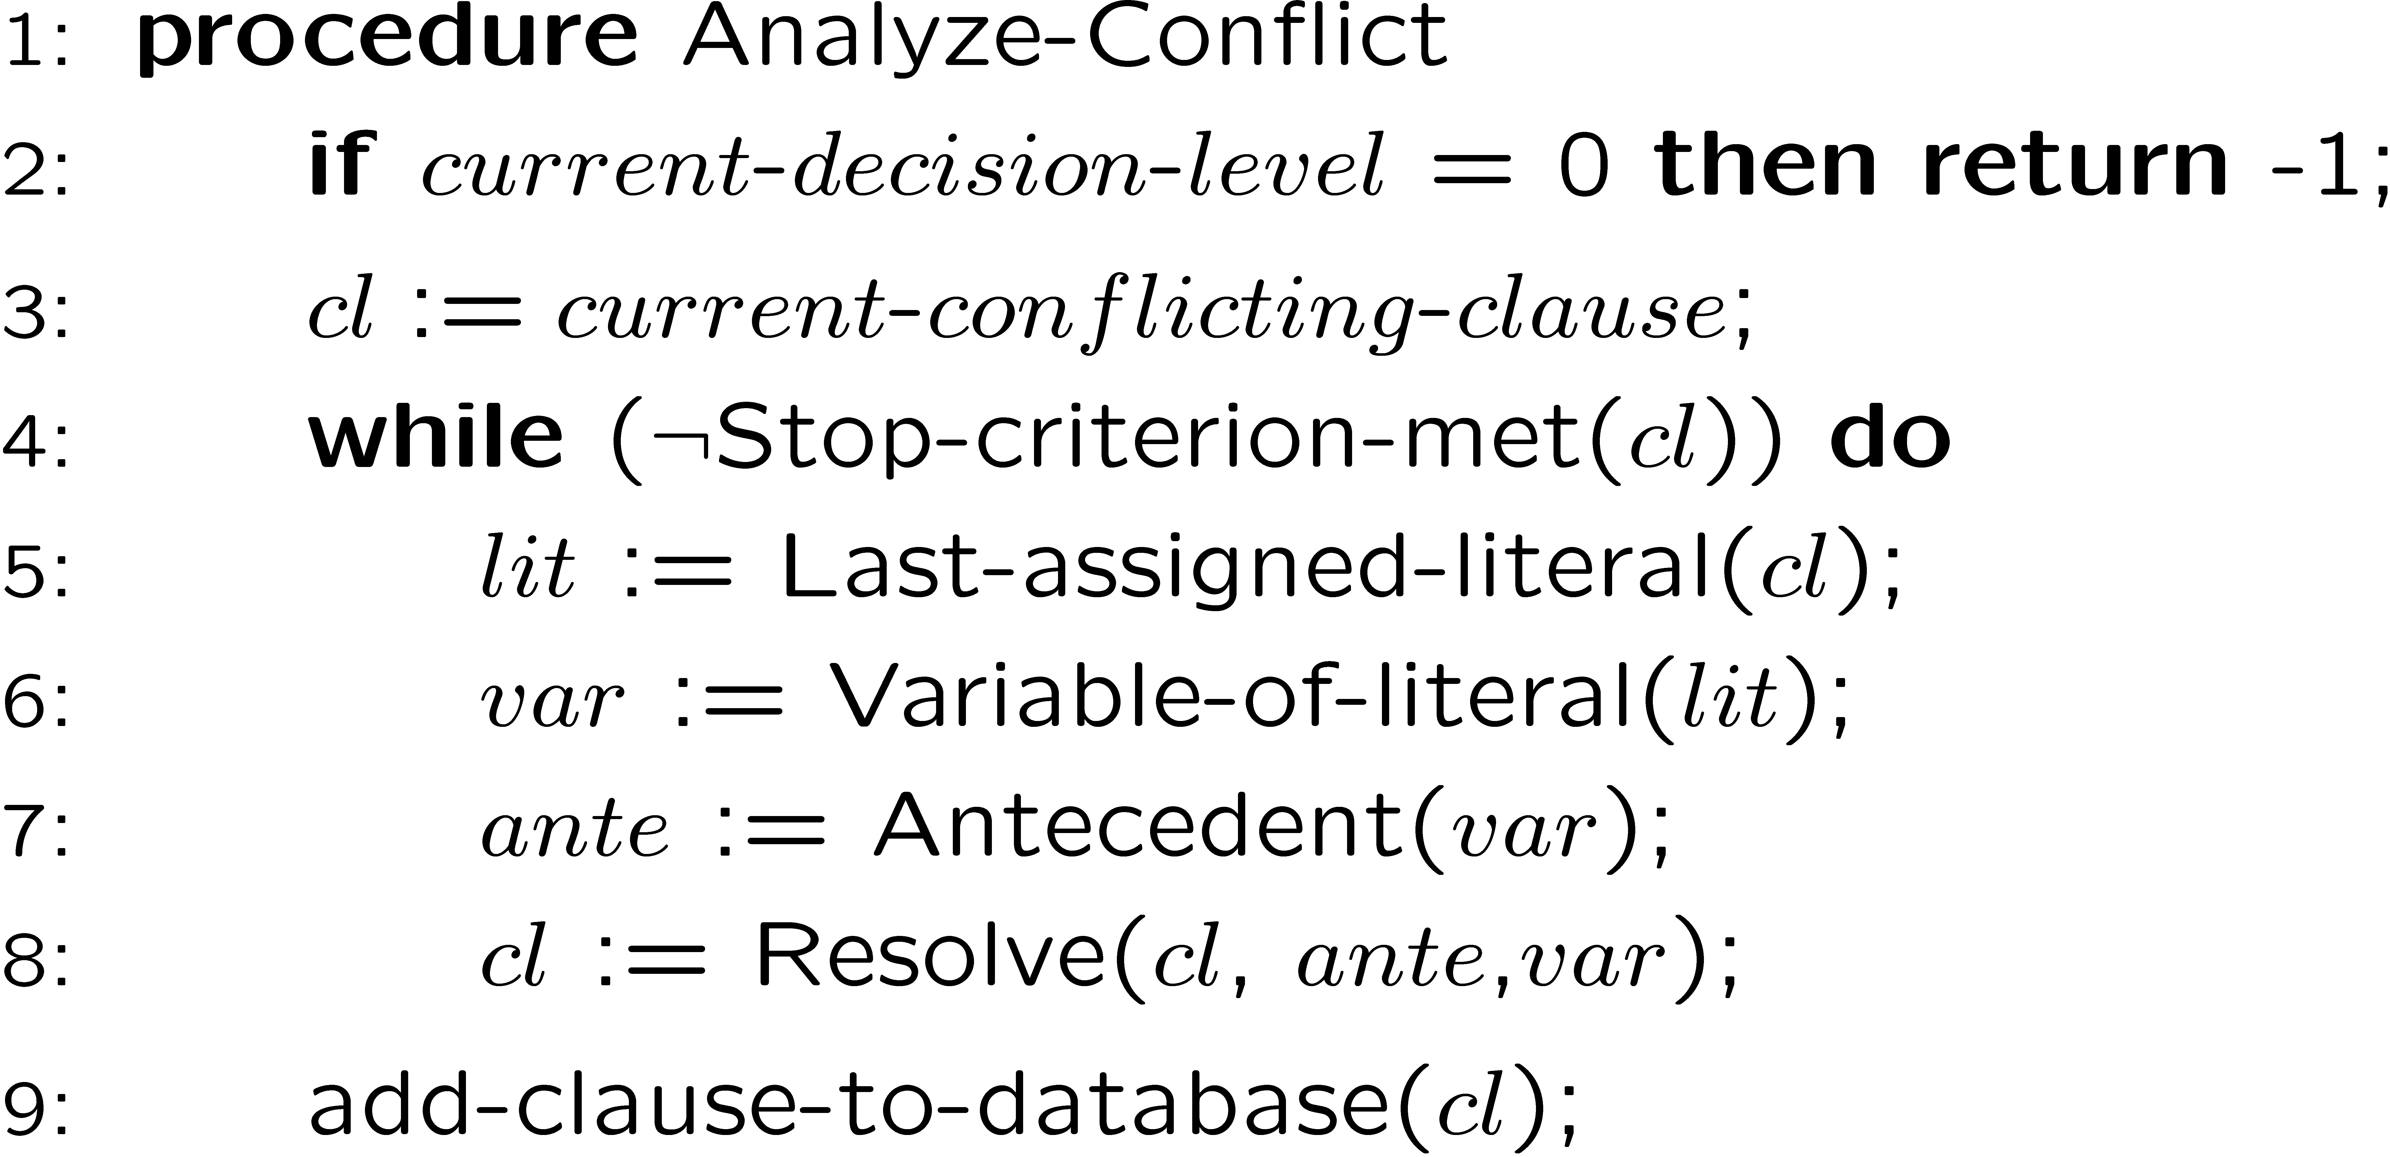
Finding the conflict clause:
cl is asserting the first UIP
Applied to our example:

Slide 4
Conflict clauses and resolution
This will be part of the
(Hyper) Resolution Graph:
c₁
c₂
c₅
c₃
c₄
Notes:
Note that all the clauses on the way are
implied by the formula (as they are a result of resolving existing clauses, or clauses derived from existing clauses), and hence can be added.
conflict clauses (but not necessarily asserting), associated with a cut separating the roots from the conflict.
4

Slide 5
The resolution graph
What is it good for ?
Example: for computing an Unsatisfiable core
[Picture Borrowed from Zhang, Malik SAT’03]

Slide 6
Minimizing the core
6
The proof is not unique.
Different proofs / different cores.
Can we find a minimum / minimal / smaller cores/proofs?

Slide 7
Minimizing the core
Core compression [ZM03,…]…
Min-core-biased search [NRS’13]
Proof compression:
Exponential-time transformations [GKS’06].
Linear time transformations
“Recycle units” [BFHSS’08]
7

Slide 8
Core compression (smaller core)
A basic approach: run until reaching a fixpoint [chaff]
initially last_core = ;
ϕ
SAT solver
core
core
core ==
last_core ?
no
last_core = core
yes
8

Slide 9











Core compression (minimal core)
Initially C’s clauses are unmarked
$$C$$
$$Remove unmarked \\ clause c∈C$$
$$SAT\left(C\right)?$$
$$No$$
$$Yes$$
$$C←core$$
$$Mark c, and \\ add it back to C$$
$$No$$
$$All clauses \\ marked?$$
$$Yes$$
$$Return C$$

Slide 10
Proof compression Example of a linear-time transformation / “Recycle-units”
Observation: When developing the implication graph (left-to-right),
… the resolution-variable is being assigned.
If it had a value, the eventual resolution would look differently
l l₁
:l l₂
l₁ l₂
Notes:
The point is that what is going to become the pivot, is only assigned when going left-to-right..

Slide 11
Example (cont’d)
Suppose that the pivot’s constant value is learned later on.
We will use it to simplify the resolution proof.

Slide 12
Recycle-units / easy case
1 3
-1 2 5
-1 4
-1 -4
2 3 5
1 -2
-1
1 3 5
3 5

Slide 13
Recycle-units / easy case
1 3
-1 2 5
-1 4
-1 -4
2 3 5
1 -2
-1
1 3 5
3 5

Slide 14
Recycle-units
1 3
-1 4
-1 -4
3
1 -2
-1
1 3 5
3
3 5
3

Slide 15
Recycle-units
Reduced proof by 4 clauses
Reduced core by 2 clauses
1 3
-1 4
-1 -4
-1
3

Slide 16
Recycle-units / beware of cycles
1 3
-1 4
-1 -4
2 3 5
1 -2
-1
1 3 5
By making this connection we created cyclic reasoning

Slide 17
Recycle-units / beware of cycles
Solution:
mark antecedents of units
apply only to unmarked nodes
1 3
-1 2 5
-1 4
-1 -4
2 3 5
1 -2
-1
1 3 5
3 5

Slide 18
Agenda
Modeling problems in Propositional Logic
SAT basics
Decision heuristics
Non-chronological Backtracking
Learning with Conflict Clauses
SAT and resolution
More techniques: decision heuristics, deduction.

Slide 19
Decision heuristics VSIDS (Variable State Independent Decaying Sum)
(Implemented in Chaff)
1. Each variable in each polarity has a counter initialized to 0.
2. When a clause is added, the counters are updated.
3. The unassigned variable with the highest counter is chosen.
4. Periodically, all the counters are divided by a constant.

Slide 20
Decision heuristics VSIDS (cont’d)
Chaff holds a list of unassigned variables sorted by the counter value.
Updates are needed only when adding conflict clauses.
Thus - decision is made in constant time.

Slide 21
Decision heuristics VSIDS (cont’d)
VSIDS is a ‘quasi-static’ strategy:
- static because it doesn’t depend on current assignment
- dynamic because it gradually changes. Variables that appear
in recent conflicts have higher priority.
This strategy is a conflict-driven decision strategy.
“..employing this strategy dramatically (i.e. an order
of magnitude) improved performance ... “

